Slide 1
Data-Driven 3D Shape Processing Shape Retrieval
Prof. Yi Fang
yfang@nyu.edu
Spring, 2016

Slide 2
Announcement
Call for final project
Reading Assignments for bag of features and dictionary learning
An introduction to sparse coding and dictionary learning
SPArse Modeling Software
Tutorial on Sparse Coding and Dictionary Learning
Project 1 will be assigned for data-driven shape retrieval
Bag-of-Features and LLC based sparse coding, bonus points: dictionary learning.

Slide 3
Review of 3D Shape Descriptors for Shape Retrieval
Learning Data-driven shape descriptor
Project One Description: Bag of Feature Shape Descriptor (BOF-D)

Slide 4
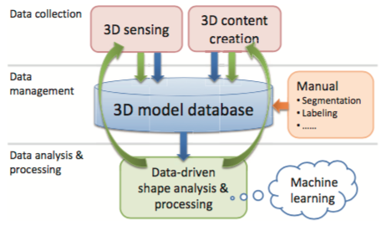
Data Driven Shape Analysis
Kai Xu, etc, Data-Driven Shape Analysis and Processing, Computer Graphics Forum, 2015
K. Xu, etc 2015

Slide 5
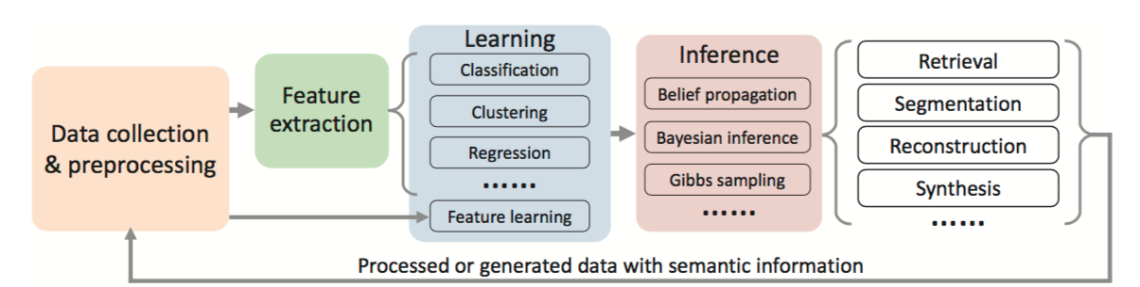
K. Xu, etc 2015

Slide 6
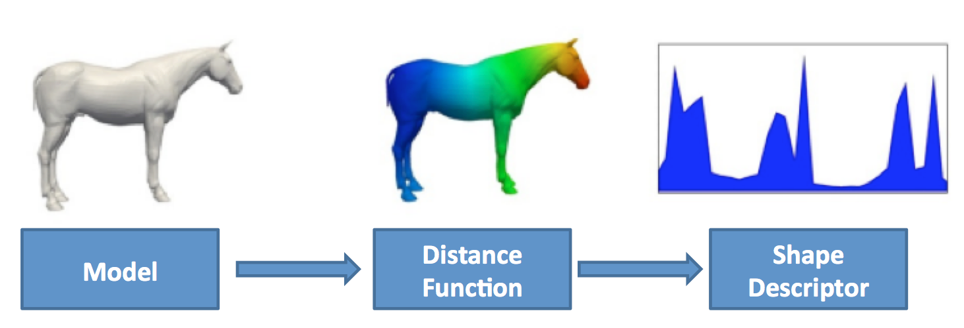
3D Shape Descriptor
Distribution based shape descriptor
Spectral shape descriptor

Slide 7
Distance Distribution descriptor
Geodesic distance between two random points
Diffusion distance between two random points
Distance between two feature vectors
Dictionary coded shape descriptor

Slide 8
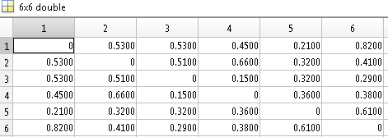
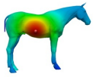
Number of Points
Distance Value

Slide 9


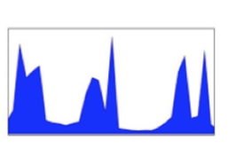


Any better idea to describe the shape?

Slide 10
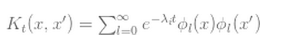
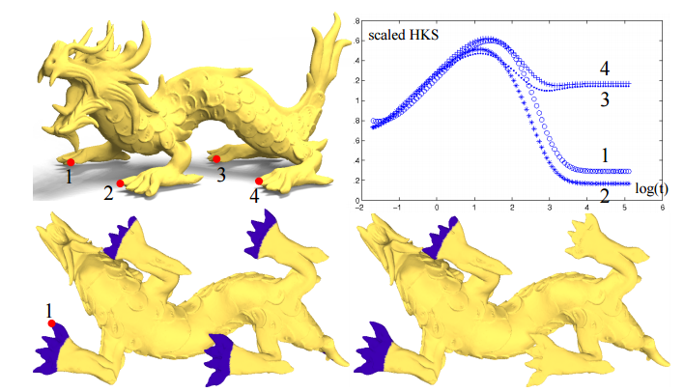
Heat Kernel Signature
1. Jian, A Concise and Provably Informative Multi-Scale Signature Based on Heat Diffusion, 2009

Slide 11
Dictionary coded shape descriptor
Measures the distribution of high-dimensional feature vectors (the bag of feature idea). Let’s first review the shape distribution idea.

Slide 12
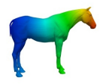
Number of Points
Distance Value

Slide 13
Two Methods
Unsupervised learning based shape descriptor
Supervised learning based shape descriptor

Slide 14
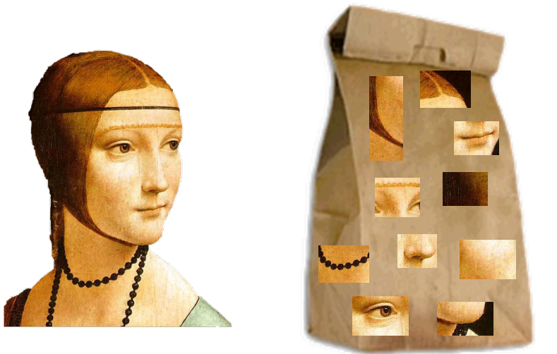
Bag-of-Feature Model
http://www.cs.unc.edu/~lazebnik/spring09/lec18_bag_of_features.pdf

Slide 15
Bag of Features Model

Slide 16
Number of Points
The ith Center of Feature vector

Slide 17
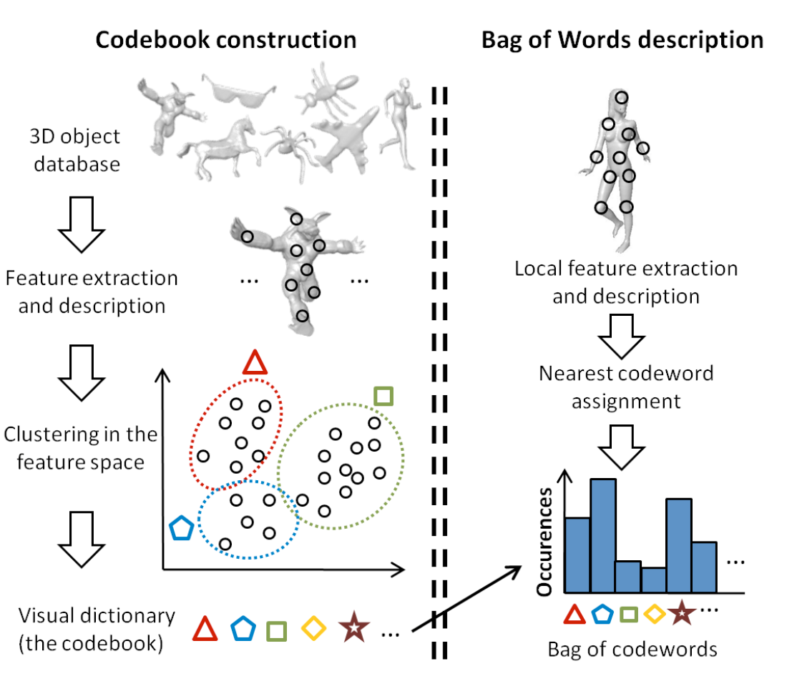
Guillaume, 2011

Slide 18
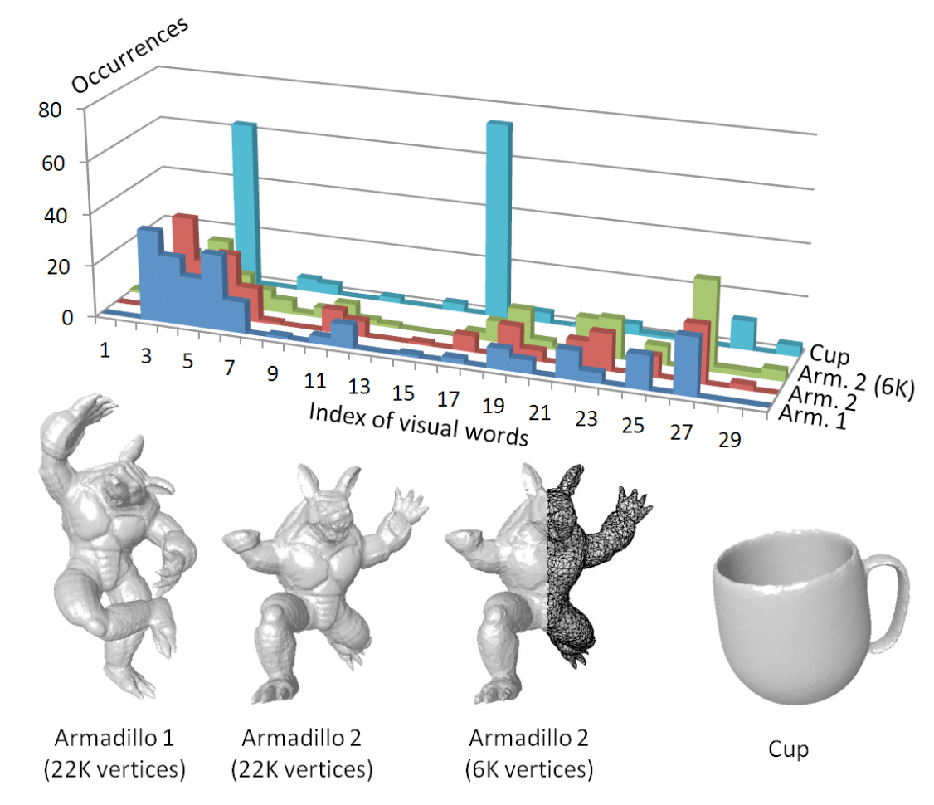

Slide 19
Implementation of BoF Model
1. Generate the codebook
2. Bag of feature generation

Slide 20
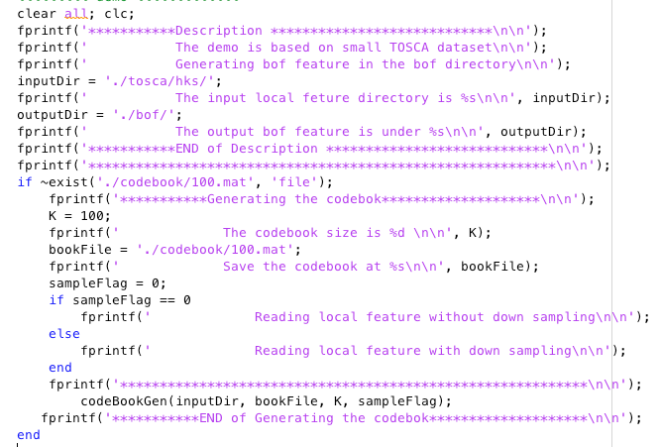

Slide 21
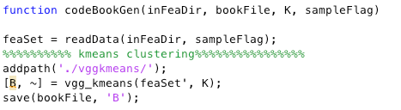
CodeBook Generation

Slide 22
BoF Generation

Slide 23
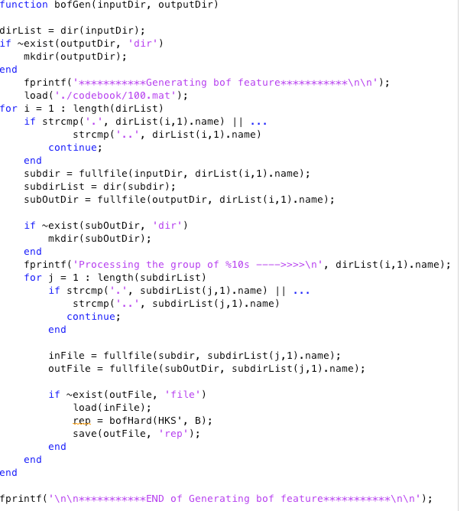

Slide 24
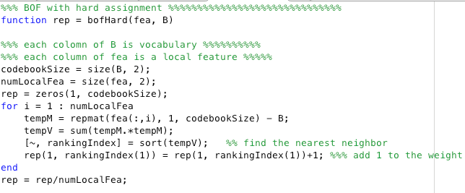

Slide 25
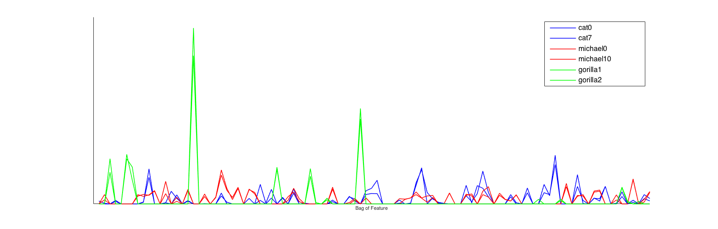

Slide 26
Discussion about BoF Model
Model Pros
Model Cons

Slide 27
Locality-constrained Linear Coding Model
Locality Constraints
Max pooling
Jinjun etc, Locality-constrained Linear Coding for Image Classification, CVPR’10.

Slide 28
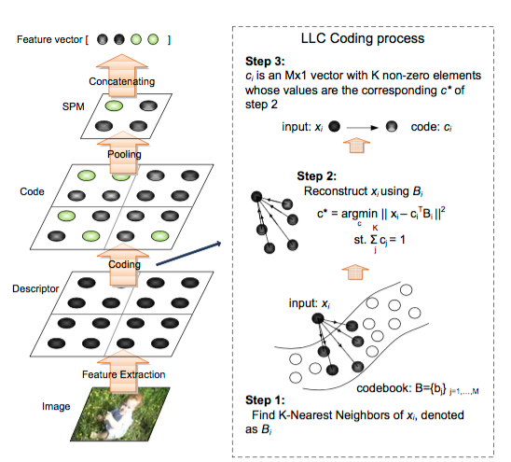
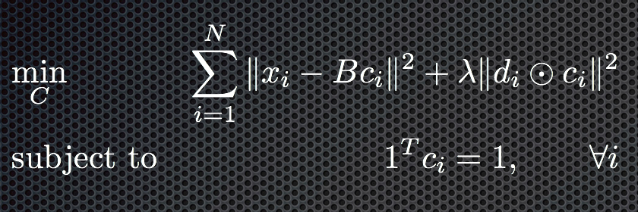
Locality-constrained Linear Coding Objective Function

Slide 29
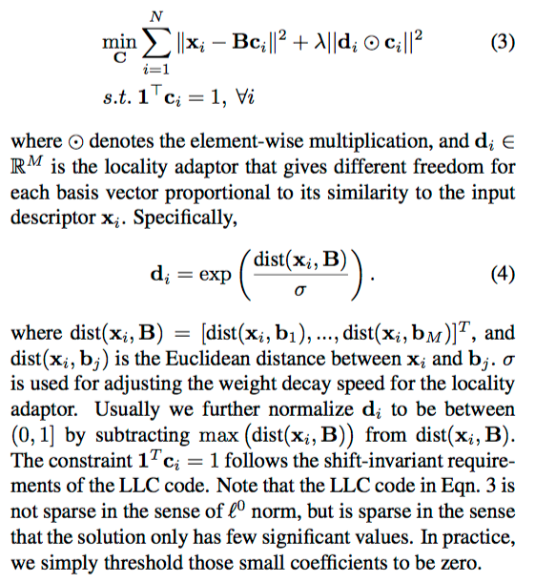
More details about the objective function:

Slide 30
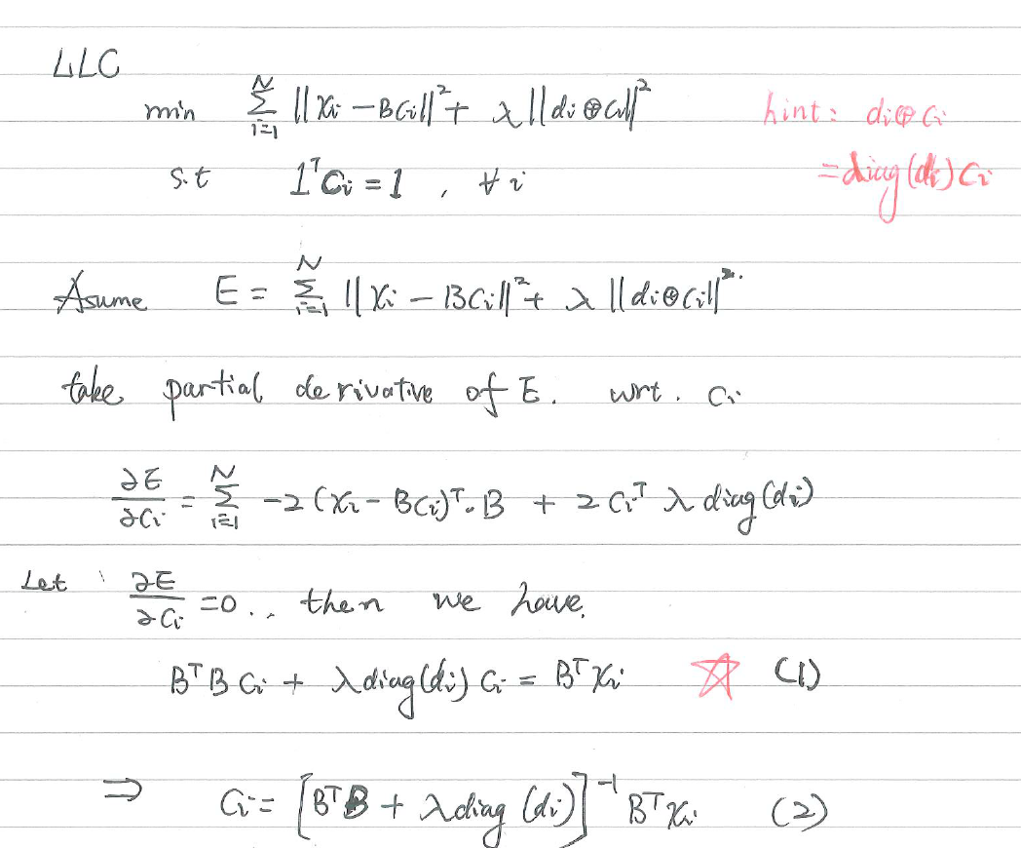

Slide 31
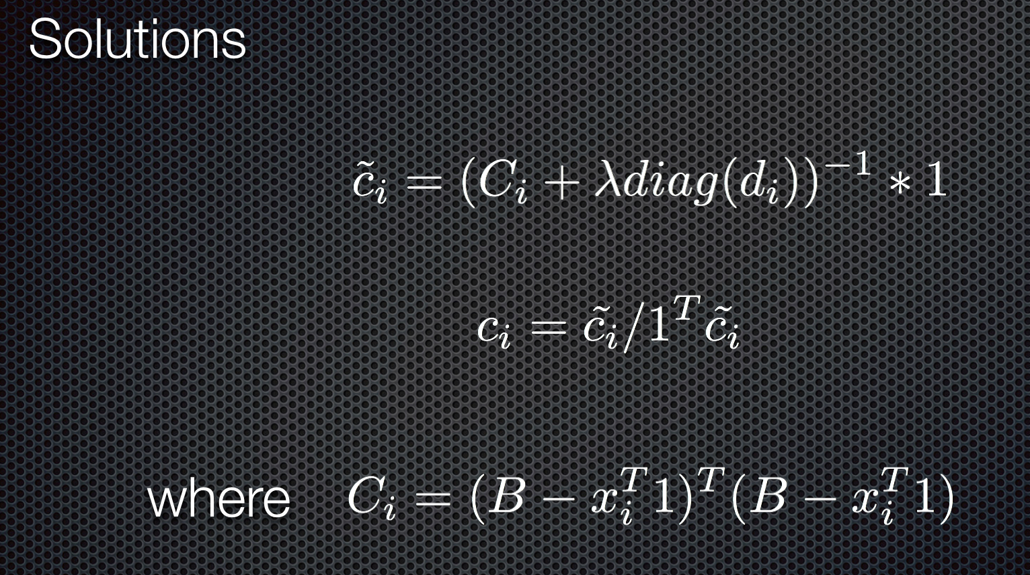

Slide 32
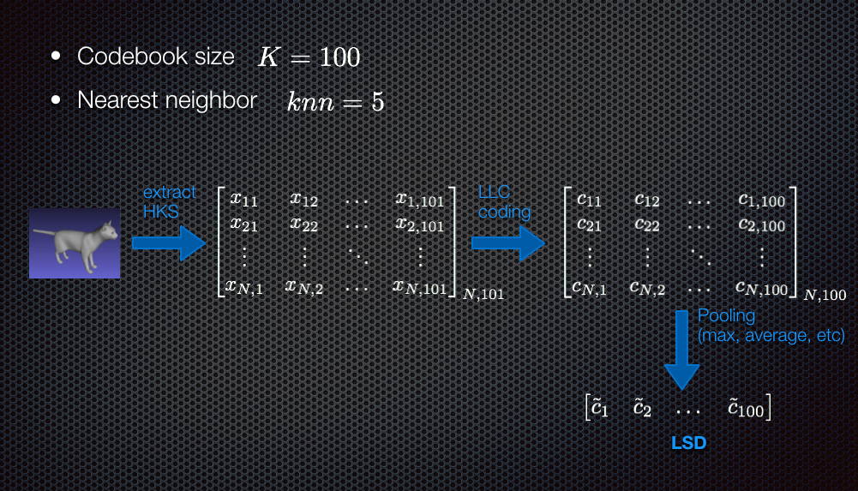

Slide 33
Codebook Generation

Slide 34
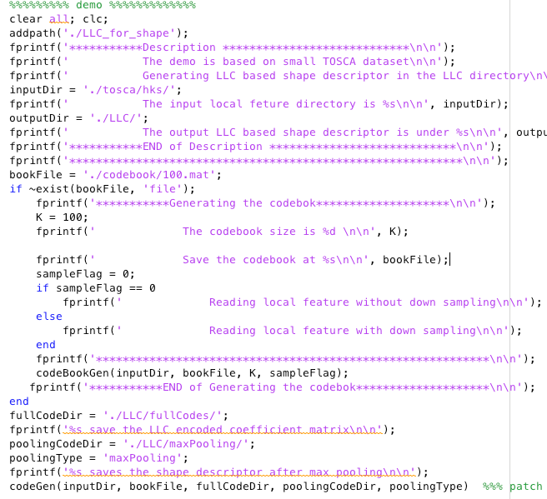

Slide 35
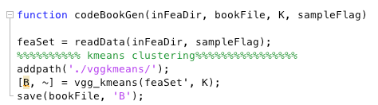

Slide 36
LLC Feature Generation

Slide 37
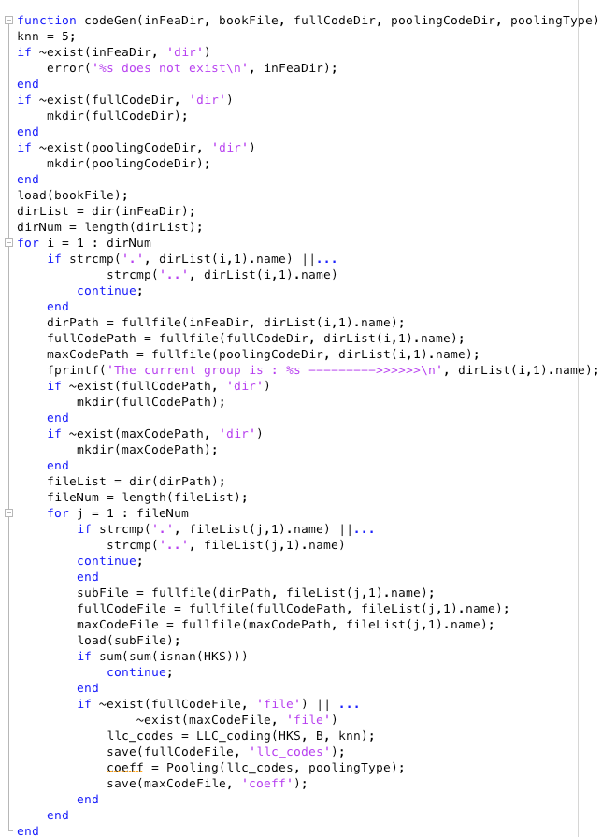

Slide 38
Difference and Relationship between BoF and LLC
BoF is actually the binary version of LLC
No pooling process in BoF

Slide 39
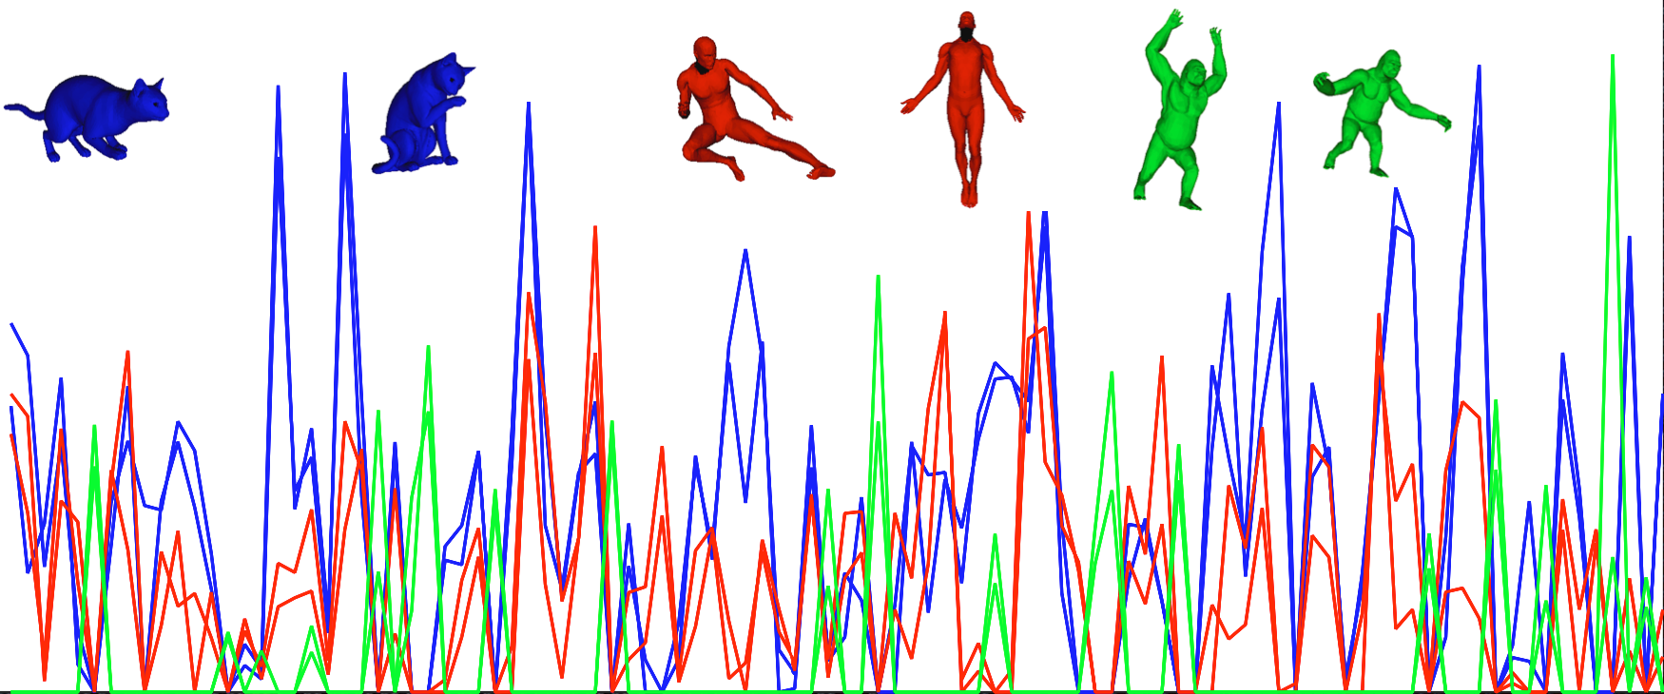
Experimental Results

Slide 40
Research Topics Seminar: 3D Deep Shape Representation

Slide 41

Background on Neural Network

Slide 42
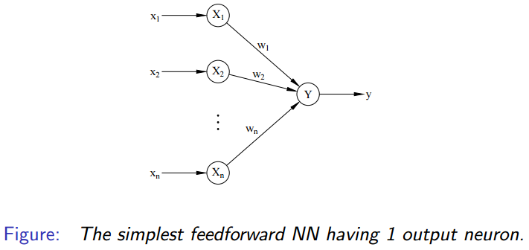

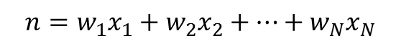

Network Architecture
Net signal received at Y is given by

Slide 43
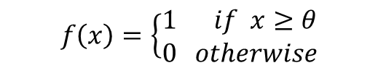

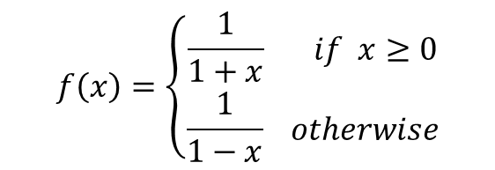
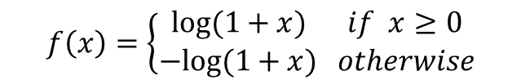
Network Architecture
Step function
Sigmoid function
Non-saturating activation function

Slide 44
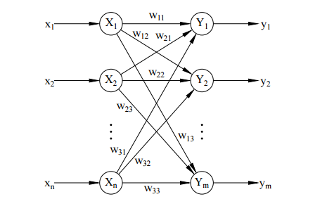
Network Architecture
Examples of single-layer NN with multiple output neutrals

Slide 45
Network learning algorithms
Supervised learning: the network is trained by presenting it a sequence of training inputs, associated with target output values.
Unsupervised learning: the network is trained by presenting it a sequence of training inputs, without associating target output value

Slide 46
Network learning algorithms
Supervised learning: the network is trained by presenting it a sequence of training inputs, associated with target output values.
Unsupervised learning: the network is trained by presenting it a sequence of training inputs, without associating target output value

Slide 47
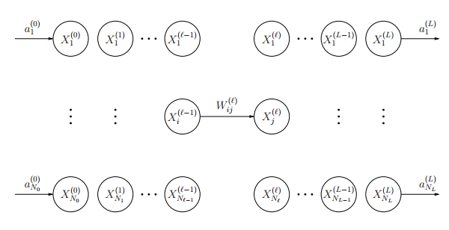

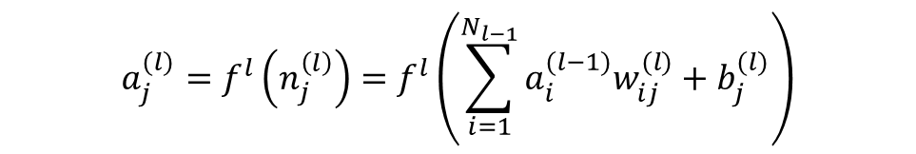
Learning algorithm
General structure of feed forward neural network

Slide 48

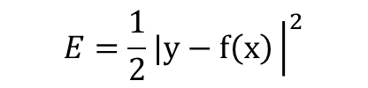
Learning algorithm
Minimizing the error function, using gradient descent

Slide 49
Neural Network Classification
Classification assigns a class membership for unlabeled shapes.

Slide 50

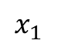
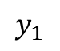
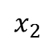
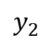
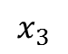

Slide 51
Regression
Regression analysis is a statistical process for estimating the relationships among variables.

Slide 52
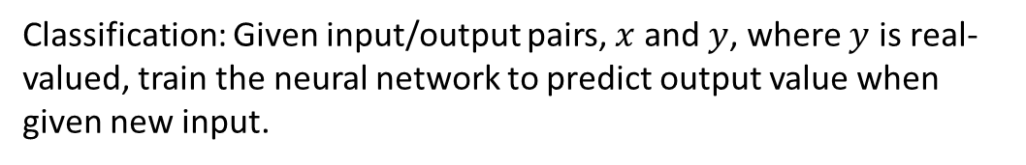
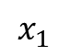
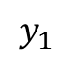
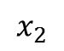
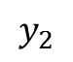
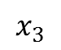

Slide 53
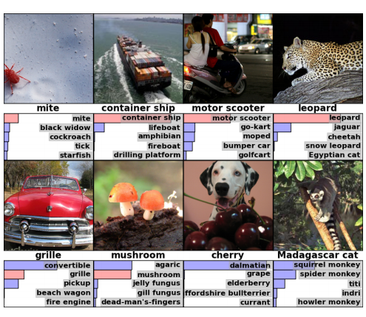
Example of classification results with deep convolution neural network
True label
5 most predicted label
True label
5 most predicted label

Slide 54
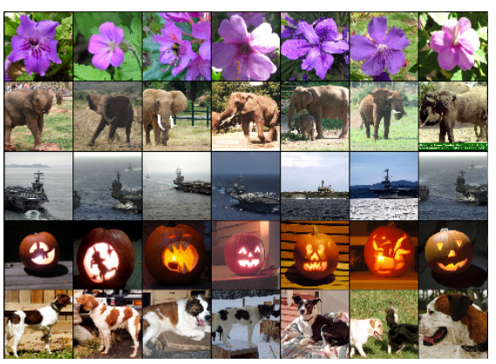
Example of retrieval results with deep convolution neural network
query
Retrieved results

Slide 55
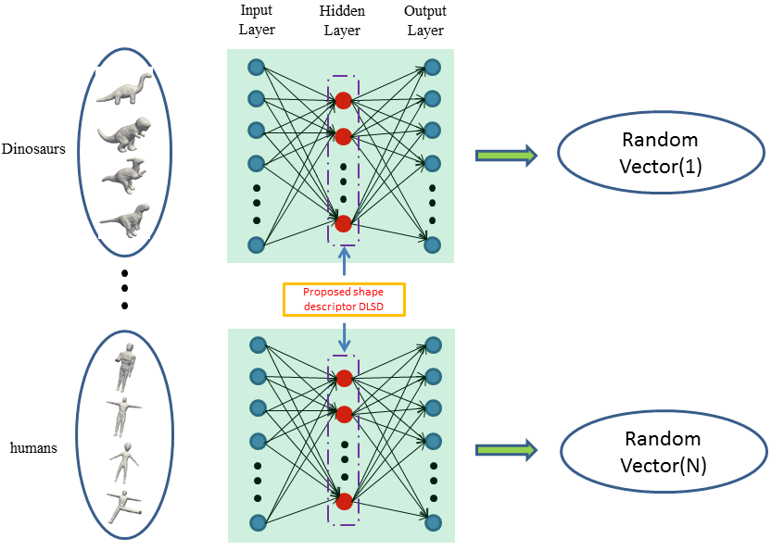
Example of regression with deep neural network

Slide 56
Deep 3D Shape Representation Yi Fang
NYU Multimedia and Visual Computing Lab Assistant Professor of Electrical and Computer Engineering
New York University, Abu Dhabi
New York University, Tandon School of Engineering
yfang@nyu.edu
Notes:
3D Shape Representation (Description)
Deep Learning based
As you can tell from the title of the talk, there are two important concepts in this talk: 3D Shape Representation and Deep Learning

Slide 57
Deep 3D Shape Description
Background & 3D shape description
Selected existing 3D shape description
Challenges in 3D shape description
Learn a 3D Shape Description
Application: 3D Shape Retrieval
Notes:
A better 3D Shape description and further boosted by Deep Learning

Slide 58
Deep 3D Shape Description
Background & 3D shape description
Selected existing 3D shape description
Challenges in 3D shape description
Learn a 3D shape description
Application: 3D Shape Retrieval

Slide 59



How to differentiate a 3D object from the other?
Which pair of 3D objects are similar to each other?
Notes:
Two Main questions we will answer today:
1. How to differentiate a 3D object from the other?
2. Which pair of 3D objects are more similar to each other?

Slide 60



3D Shape Description
1
0
1
1
1
0
0
1
1
1
1
1
1
0
0
1
1
1
Notes:
First of all, we need to a type of digital representation or description that can be used to describe the 3D model.

Slide 61
Deep 3D Shape Description
Background & 3D shape description
Selected existing 3D shape description
Challenges in 3D shape description
Learn a 3D shape description
Application: 3D Shape Retrieval

Slide 62
Three Typical Descriptions
Volumetric Representation
2D view projections
Shape distribution
Notes:
We roughly have three types of shape representations broadly. The first two representation is a kind of straightforward of image processing. People is trying to find a direct representation of 3D shape based on the grids of 2D image. For instance, we can easily find volumetric representation The last presenation is of primary interests prior to deep learning emerging. It is more intrinsic geometric essence

Slide 63


Volumetric Representation
Xiao, etc, CVPR 2015
mesh
binary voxel
Notes:
Now you can think of what would be the issue of this representation?

Slide 64


2D Projections
Bai, etc, 2014
Johan, etc, 2008

Slide 65


Shape Distribution
Fang, etc, 2011
Gal, etc, 2007

Slide 66
Deep 3D Shape Description
Background & 3D shape description?
Selected existing 3D shape description?
Challenges in 3D shape description?
Learn a 3D Shape Description
Application: 3D Shape Retrieval

Slide 67
Challenges in 3D shape description
Shape Deformation
Shape Structural variation

Slide 68



Alignment?
Huang, etc, 2012
Notes:
A lot of efforts have to be spent for a consistent alignment to avoid introducing the variance for the parameterization a 3D shape surface (etc.)

Slide 69

Shape Deformation
Notes:
Even with a very good alignment, we still face some issues of 3D shape deformation. Which will introduce lots of variance for 2D projections.

Slide 70





Shape Structural Variation
Notes:
Here is additional example for the shape alignment and projections issues for the 3D shape analysis, etc, which would be good for shape registration and retrieval

Slide 71
Deep 3D Shape Description
Background & 3D shape description
Selected existing 3D shape description
Challenges in 3D shape description
Learn a 3D Shape Description
Application: 3D Shape Retrieval

Slide 72
Learn a 3D shape description
A better hand-craft shape description
Learned shape description from hand-crafted description
Notes:
We will need a better hand-crafted shape description other than directly alignment and projections. As you can think, those two parameterization is the most straightforward way to bring the 2D images processing techniques to 3D shape analysis. However, since the information of 3D and 2D domains are different. For instance, 3D shape most case, we are missing rich color information but with geometric information as the primary information in this case. Whereas, the 2D image has very rich color and semantic information instead. Therefore, a direct extension of image prococessing techniques to 3D would be of some problems. Two ways to improve the shape representation: 1. better hand craft shape description, 2) learning techniques to learn out the variance

Slide 73
A better hand-craft shape description: Heat Shape Descriptor (HeatSD)
Notes:
We are

Slide 74


Heat Equation
The heat flow across the graph is governed by the heat equation:
Where is a function reflecting the heat distribution evolved with the time , denotes a node of the graph and denotes the Laplacian operator

Slide 75


Heat Diffusion Process
Heat diffusion is controlled by how well data points are connected to each other.
Heat Source
Heat Source

Slide 76


Slide 77

Temperature Distribution (TD) Description
Fang, etc, 2011
1
2
3

Slide 78



Point temperature distribution
A
B
C

Slide 79

Average temperature distribution
Average out
0.0961
A
Heat Kernel matrix
0.0399
0.0983
B
C

Slide 80




Mapping the shape with average temperature distribution
Fang, etc, 2011

Slide 81
Build the TD descriptor
Number of Vertices
Average temperature
A
B

Slide 82

Multi-scale TD Shape Descriptor: HeatSD
Distribution at one-scale
Stacking multi-scales
Fang, etc, CVPR 2015

Slide 84
Properties of HeatSD
Alignment-Free
Invariant to isometric deformation
Robust to structural variation
Notes:
Go back and for the show the properties of the Heat Shape Descriptor

Slide 85
Learned shape description from hand-crafted description: Deep Shape Descriptor (DeepSD)
Notes:
We are

Slide 86
Deep Shape Descriptor (DeepSD)
Many-to-one encoder¹
Discriminative Auto-encoder²
^{1,2}Fang, etc, CVPR 2015

Slide 87
Many-to-Encoder

Slide 88

Many-to-one encoder: Deep Neural Network
Unique Shape
Deep Shape Feature
Fang, etc, CVPR 2015

Slide 89
Input and Target Layer
Input Shape Descriptor
Heat Shape Descriptor (HeatSD)
Target Shape Descriptor
Eigen-shape descriptor
Fish-shape descriptor

Slide 90
Input Layer: HeatSD
HKS Distribution at one-scale
Stacking multi-scales

Slide 91
Output Layer:
EigenShape Descriptor
FisherShape Descriptor

Slide 92


Slide 93
Learning Deep Shape Descriptor

Slide 94
Discriminative Auto-encoder

Slide 95
Recall: HeatSD
HKS Distribution at one-scale
Stacking multi-scales

Slide 96

Fang, etc, CVPR 2015

Slide 97


Slide 98


Slide 99
Deep 3D Shape Description
Background & 3D shape description
Selected existing 3D shape description
Challenges in 3D shape description
Learn a 3D Shape Description
Application: 3D Shape Retrieval

Slide 100
3D Shape Retrieval

Slide 101




Problem Setting
3D shape retrieval is a fundamental low-level task with applications in areas as diverse as computer vision, computer-aided design, bio-informatics, and 3D medical shape processing.
Do these models fall into the same category?

Slide 102






General shape retrieval process
Representing a 3D shape using descriptor
Comparing shapes by comparing the descriptors
0.9651
0.4501

Slide 103
Experimental Result
HeatSD VS DeepSD
Robust to Noise
Robust to Shape Deformation

Slide 104

Shape Google Dataset

Slide 105

HeatSD V.S. DeepSD

Slide 106

Robust to noise

Slide 107

Robust to shape deformation
SHREC’10 Shape dataset

Slide 108

Robust to shape incompleteness

Slide 109

Please Visit NYU MMVC Lab for more details:
https://wp.nyu.edu/mmvc/

Slide 110
Thank you & Questions!

Slide 111
3D Retrieval
3D Shape Descriptors
3D Shape Matching and Retrieval

Slide 112










3D Shape Matching and Retrieval
Shape matching: measure of similarity (distance) between 3D models
match
,
dist
,
Shapes could have deformation, rotation, translation, noise, etc. Distances should have the following properties:
Distances of shapes from the same class should be small
Distances of shapes from the different classes should be large
dist
is small
dist
is large

Slide 113











3D Shape Matching and Retrieval
Shape retrieval: given a query, 3D model, return similar models in a large database
Retrieval example
query
database

Slide 114

3D Shape Matching and Retrieval
Shape retrieval including two steps:
Shape matching, computing distance between query and shape from the dataset
Ranking all the distances, returning those top ranking objects.
dist
,
How to compute
dist
Feature
vector
Feature
vector
Shape descriptor
shape descriptor is fixed -dimensional vector
mapping shape from the original space to feature space
similarity of different shapes could be directly determined by the distances of their shape descriptors

Slide 115
Data-driven 3D retrieval
Shape Google
Deep learning

Slide 116
Shape Google
Alexander Bronstein (TOG2011) generalize BoF model to construct shape descriptor for shape retrieval
Main contribution:
Generalize BoF model from computer vision to shape retrieval problem
Consider spatial information of “vocabulary” to improve performance
Adopt metric learning to represent the shape as a binary code.

Slide 117
Shape Google
Brief introduction to bag-of-feature model
Extract local features
Generating codebook
Quantize features using entry in the codebook,
Represent shape by frequencies of entry in the codebook
Many content is from “http://www.cs.unc.edu/~lazebnik/spring09/lec18_bag_of_features.pdf”

Slide 118

Shape Google
BoF for shapes
Extracting HKS as local features, then apply BoF and spatially-sensitive BoF to get a global descriptor as follows:
Many content is from “Shape Google: Geometric Words and Expressions for Invariant Shape Retrieval”

Slide 119
Shape Google
Example of shapes

Slide 120

Shape Google
Experimental results

